Slide 1


Chapter 9: Databases

Slide 2
Overview
This chapter covers:
  What a database is, the individuals who use them, and how databases evolved
  Important database concepts and vocabulary
  Database classifications and models
  The relational database
  How databases are used on the Web

Slide 3
What Is a Database?
Database
  A collection of related data stored in a manner that enables information to be retrieved as needed
Database Management System (DBMS)
  Used to create, maintain, and access databases
  Database engine
    The part of the program that actually stores and retrieves data
  Microsoft Access, OpenOffice Base, Corel Paradox, Oracle
Database, etc.

Slide 4
What Is a Database?
A database typically consists of:
  Tables
    Collection of related records
  Fields (columns)
    Single category of data to be stored in a database (name, telephone number, etc.)
  Records (rows)
    Collection of related fields in a database (all the fields for one customer, for example)

Slide 5
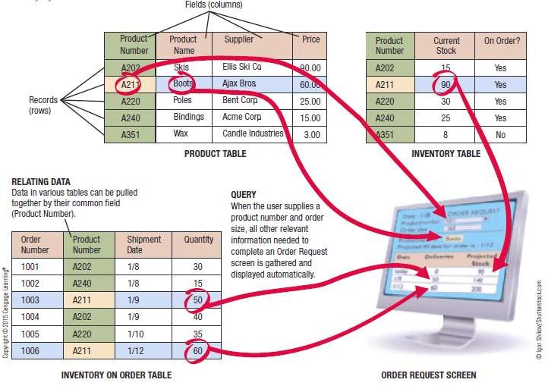

What Is a Database?
A Simple Relational Database Example

Slide 6
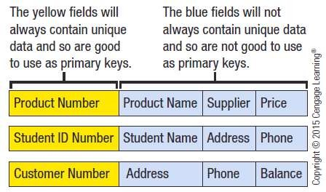
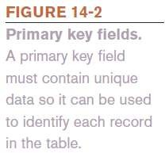
What is a Database?
Primary Key
  Field that uniquely identifies the records in a table
  Field in a table that is used to relate that table to other
tables

Slide 7
What Is a Database?
Individuals Involved with a Database Management System
  Database Designers
    Design the database
  Database Developers
    Create the database
  Database Programmers
    Write the programs needed to access the database or tie the database to other programs

Slide 8
What Is a Database?
Database Administrators
  Responsible for managing the databases within an organization
Users
  Individuals who enter data, update data, and retrieve information from the database

Slide 9
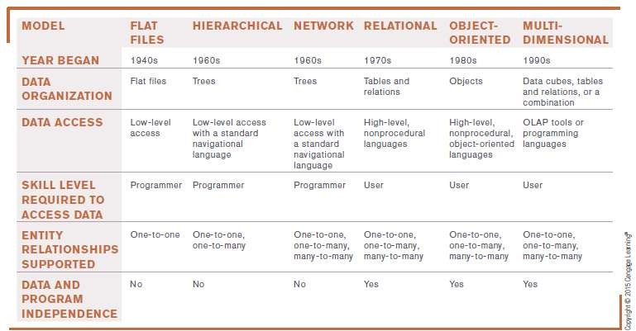
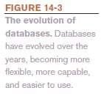
What Is a Database?
The Evolution of Databases

Slide 10
What Is a Database?
Advantages and Disadvantages of the DBMS Approach
  Advantages
    Low level of redundancy
      Faster response time
      Lower storage requirements
      Easier to secure
      Increased data accuracy
  Disadvantages
    Increased vulnerability (backup is essential)

Slide 11
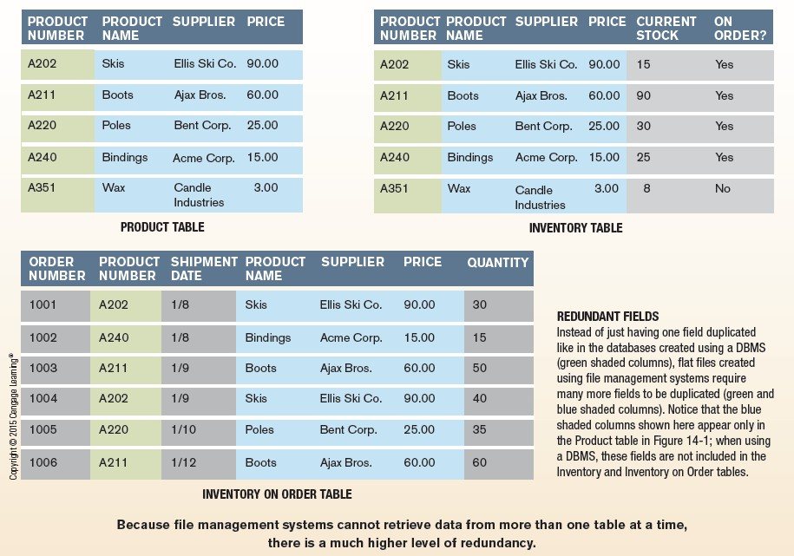
Inside the Industry Box
File Management Systems
– Tables are not related so more time- consuming and more redundancy

Slide 12
Data Concepts and Characteristics
Data Hierarchy
  Fields/columns
    Hold single pieces of data
  Records/rows
    Groups of related fields
  Tables
    Collection of related records
  Database
    Contains a group of related tables

Slide 13
Data Concepts and Characteristics
Entities and Entity Relationships
  Entity
    A person, object, or event of importance to the
organization
    Entities that the organization wants to store data about typically becomes a database table
  Attributes
    Characteristics of an entity
    Typically become fields in the entity’s database table
  Relationship
    An association between two or more entities

Slide 14
Data Concepts and Characteristics
One to One (1:1) Entity Relationships
  One entity is related to only one other entity of a particular type
  Not a common type of relationship
One to Many (O:M) Entity Relationship
  Most common type of relationship
  One entity can be related to more than one other entity
– A supplier can supply more than one product to a company
Many to Many (M:M) Entity Relationships
  One entity can be related to more than one other entity, and those entities can be related to multiple entities of the same type as the original entity

Slide 15
Data Concepts and Characteristics
Data Definition
  The process of describing the properties of data to be included in a database table
  During data definition, each field is assigned:
    Name (must be unique within the table)
    Data type (such as Text, Number, Currency, Date/Time)
    Description (optional description of the field)
    Properties (field size, format of the field, allowable range, if field is required, etc.)
  Finished specifications for a table become the table structure

Slide 16
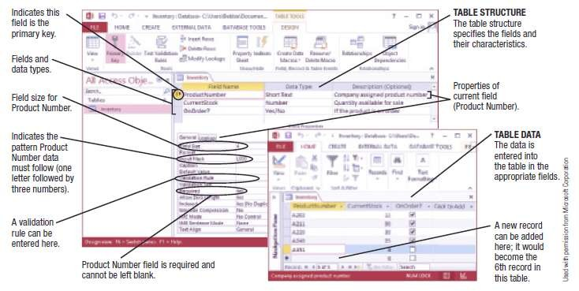
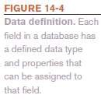
Data Concepts and Characteristics

Slide 17
Data Concepts and Characteristics
The Data Dictionary
  Contains all data definitions in a database, including:
    Table structures
    Security information (passwords, etc.)
    Relationships between the tables in the database
    Basic information about each table, such as the current
number of records
  Does not contain any of the data in the tables
  Does contain metadata, which is information about the database tables
  Ensures that data being entered into the database does not violate any specified criteria

Slide 18
Data Integrity, Security, and Privacy
Data Integrity
  Accuracy of Data
    Quality of data entered determines the quality of
generated information
  Data Validation
    Process of ensuring that data entered into the database is valid
    Record validation rules
– Checks all fields before changes to a record are saved
    Can be enforced on a per transaction basis so the entire transaction will fail if one part is invalid

Slide 19
Data Integrity, Security, and Privacy
Data Security
  Protects data against destruction and misuse
  Protects against unauthorized access to and unauthorized
use of a database
  Database activity monitoring programs can be used to detect possible intrusions and risks
  Prevents data loss
  Should include strict backup and disaster-recovery procedures (disaster-recovery plan)
  Should be used with both in-house and cloud databases

Slide 20
Data Integrity, Security, and Privacy
Data Privacy
  Growing concern because of the vast amounts of personal data stored in databases today
  Many states require businesses to notify customers when their personal data has been compromised
  Data breaches can be costly
– One estimate is $200 per breached record

Slide 21
Meta data
Metadata refers to data that provides information about other data. It describes various aspects of data, such as its structure, origin, format, and context. Metadata can be thought of as "data about data.“
Metadata provides context and helps users interpret and use data effectively. It includes details such as data source, creation date, authorship, and relationships between different datasets.

Slide 22
DBMS Manages Interaction
A Database Management System (DBMS) is a software application that efficiently and securely manages the interaction between users, applications, and the underlying database. It serves as an intermediary that facilitates the storage, retrieval, and manipulation of data in response to user queries and application requests.
It ensures that users and applications can interact with the database securely and efficiently, while also handling internal processes to maintain data integrity and optimize performance.

Slide 23
Improved Data Sharing
DBMS Improved data sharing refers to the streamlined and secure sharing of data among users and applications within an organization.
Key features of Data Sharing includes:
Efficient Collaboration: Centralized platform for teamwork.
Data Consistency: Up-to-date and accurate information for all users.
Access Control: Robust mechanisms for defining and enforcing user permissions.

